Slide 1
HANDWRITTEN DIGIT RECOGNITION
SUNKARA BHAVANA REDDY
R170909
E-3,CSE

Slide 2
INTRODUCTION
Machine learning and deep learning plays an important role in computer sciences and artificial intelligence.Handwritten digit recognition has gained a good amount of popularity from the very beginning of machine learning and deep learning.
The identification of hand-written digits is amoung the most significant issue in the application for pattern detection. In many applications such as postal code, check online routing bank accounts, data form entry,etc. .
The applications of digits recognition include the centre of issue is the need to construct an appropriate algorithm that can recognise written digits and that users upload through scanner and other digital device.

Slide 3


Slide 4
TOOLS USED
1. NUMPY:
NUMPY is a library for the python programming language, adding support to large multidimensional array and metrices.This package contains large collection of high level mathematical functions to operate on arrays. NUMPY is an open sorce and has many contributors.
2.TENSORFLOW:
It is an end-to-end open source package in python for machine learning . It has a flexible ecosystem of tools, libraries and resources that let researchers push the state of art in ML and easily built and deploy ML powered applications.

Slide 5
3. Convolutional Neural Network:
CNN is a deep learning neural network used for processing structured arrays of data.
CNN is a feed forward neural network with convolutional layers assembled on top of each other, each one recognises more sophisticated shapes. It has some group of layers and hidden layers followed by activation layers.
With 3 or 4 layers we can easily recognize handwritten written digits and with 25 layers we can easily differentiate human faces.

Slide 6
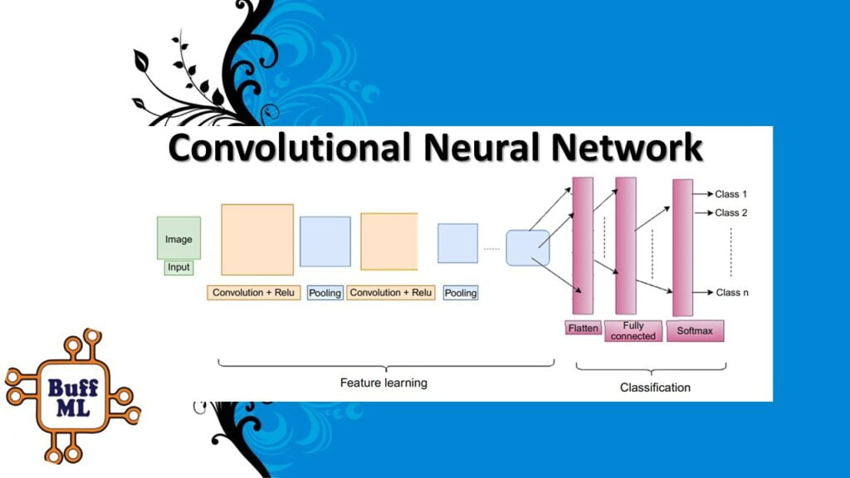

Slide 7
Implementation
1. We import neccesary libraries:
import tensorflow as tf
from keras.preprocessing.image import ImageDataGenerator
import numpy as np
import tensorflow.keras.utils as tku
2. Preprocessing trainig set and test set
In preprocessing we load the dataset from directory , and we make all the dataset of eaqual size of 28x28 pixels and images are grayscale. We also use one hot encoding using categorical () util function.

Slide 8
Initialising CNN
1) Convolution: Here we define the baseline CNN model. We first start with one layer with some number of filters(32) and a Relu activation function.
Pooling layer: Pooling layers provide an approach to down sampling feature maps by summarizing the presence of features in patches of the feature map. Two common pooling methods are average pooling and max pooling
2)Adding second convolutional layer: Here also we follow the same steps.
3)Flattening:Flattening is converting the data into a 1-dimensional array for inputting it to the next layer.
4)Output layer : After we flatten all layers we go to output layer and we use softmax activation function.

Slide 9
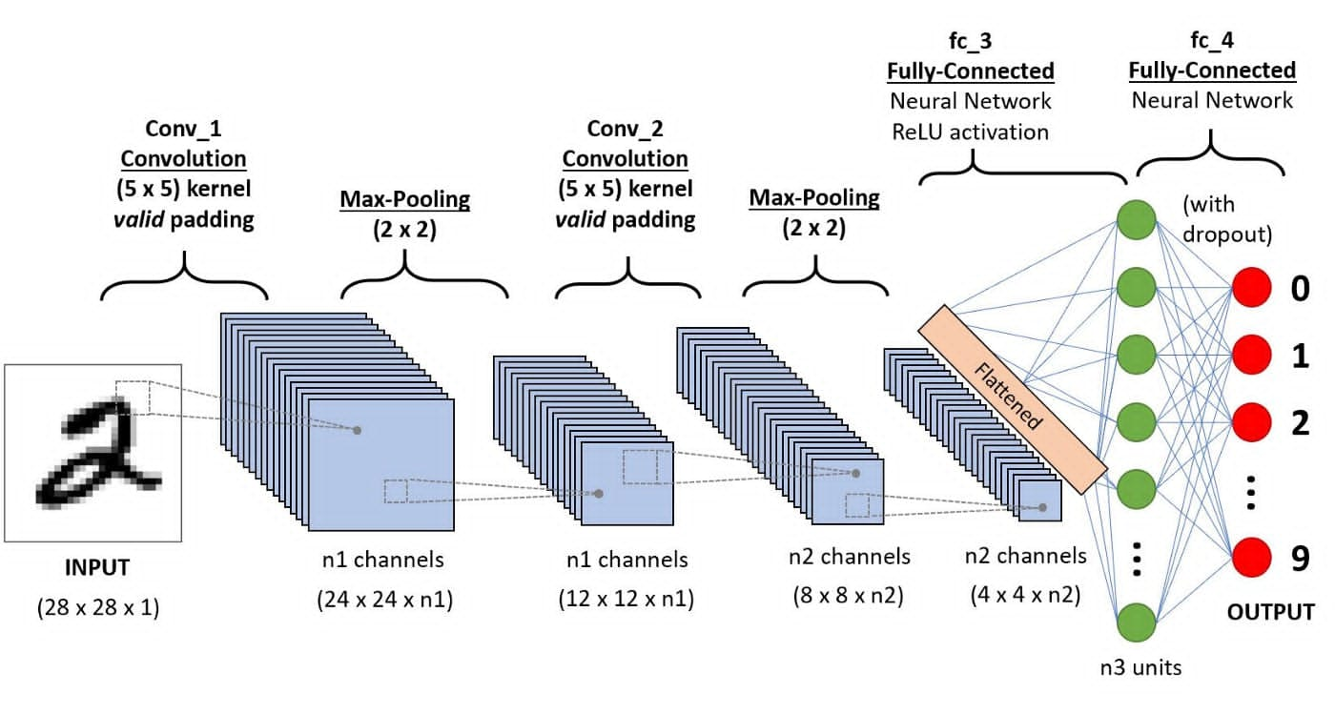

Slide 10
Training CNN
5) Compiling the CNN: We compile the CNN using categorical cross entropy .Cross-entropy is a measure from the field of information theory, building upon entropy and generally calculating the difference between two probability distributions.
6) Training the CNN on the Training set and evaluating it on the Test set : After compilation we start training the trainig set and validate it on test set. Here we use 20 epochs.An epoch is made up of one or more batches, where we use a part of the dataset to train the neural network
After we train the model we get 98.94% accuracy and loss of 0.3% on training set
And 98.52% accuracy and 0.5%loss in test set.

Slide 11
Making a prediction
To make a prediction we take a single image from test set and load it in our model from directory and check for its results.
Then we convert our image into an array data and check for its prediction from numpy array.
Example : If result =[[0. 0. 0. 0. 0. 0. 0. 0. 1. 0.]]
Then prediction is : Eight
If result =[[0. 0. 1. 0. 0. 0. 0. 0. 0. 0.]]
Then prediction is : Two

Slide 12
Conclusion
We practiced machine learning techniques including use of Tensorflow and Convolutional neural network to obtain the appropriate digit recognition .We built handwritten recognizers evaluated their performances on MNIST (Mixed National Institute of Standards and Technology) dataset and then improved the training speed and the recognition performance.
The error rate thus obtained is of 0.3% and training accuracy is 98.94% and test accuracy 98.52% demonstrating significant and promising performance.
Thus by practicing this we have achieved success in properly identifying the digits drawn at different angles and properly displaying the correct digit at a single turn.
Hence the system would be able to recognize the introduced digit according to the formations made and according to the values in the dataset.

Slide 13
THANK YOU

